Slide 1

Web Applications – part 1
From Thick to Thin to Thick…
Trainers: Daniela-Oana BESLIU
Mihai VADUVA
Andrei Marica
Tekin Omer-Ali
Authors: Viorel TACLICIU
Adrian DAFINOIU

Slide 2

Contents
Tools
Web Development Introduction
JEE Containers
Apache Tomcat
Java Web applications - architecture
Request - Response model
HTTP
Servlets
Q&A

Slide 3
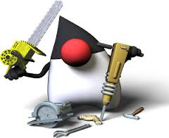





Tools
Java
Apache Maven
Intellij Idea
Apache Tomcat
Docker
Notes:
Ingredient, o piesa a unui ansamblu.
In industria software :
Componenta este o parte complexa, aproape independenta, o parte inlocuibila a unui system si indeplineste o functie clara in contextul unei arhitecturi bine definite.

Slide 4
Web Development Introduction

Slide 5

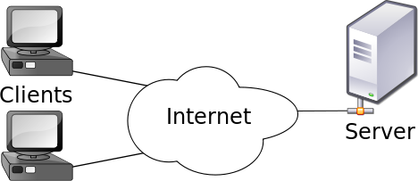
Web Development Introduction
Client-server model
Is a distributed application structure that partitions tasks or workloads between the providers of services and services requesters
Client – is the part that makes a request to a service
Server – is the part that actually provides services to it’s clients. A server could also act as a client and vice versa

Slide 6

Web Development Introduction
Repeated cycles - thick client to thin client, to thick…
Thick client (heavy, rich or fat client) is a computer (client) in a client – server architecture that typically provides rich functionality independent of the central server. A fat client still require a connection to a network or a server, but also has the ability to perform many functions without that connection
Thin client, in contrast, generally does little processing
From Swing Applications to JSP/Servlets Application to Angular JS Applications
Notes:
Istoric: Cicluri intre thick (fat) client (Swing, Oracle Forms) – la thin (slim) client (JSP) - spre thick client (Angular)

Slide 7
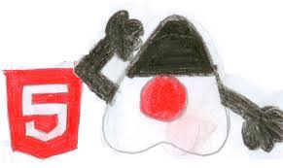
Web Development Introduction
Until some 5 years ago we developed web application using thin clients
Now we develop web application based on browser-centric HTML5 applications talking to thin-servers
Our technology stack is based on rich clients (Angular JS) and the server provides services to these clients

Slide 8
JEE Containers & Web Container

Slide 9

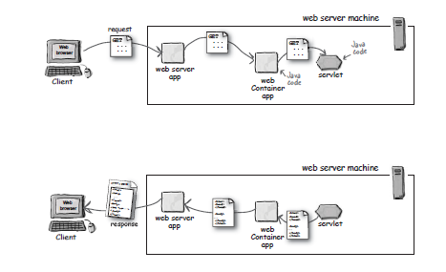
JEE Containers & Web Container
Are the interface between a Java component and the low-level platform-specific functionality
Provide separation of business logic from resource and lifecycle management
This allows developers to focus on writing business logic rather than writing enterprise infrastructure
The Java EE platform uses "containers" to simplify development

Slide 10
Web Container
The web container is the interface between web components and the web server.
The web container
Communication Support
Lifecycle Management
Multi-threading support
Security
JSP Support
A web component can be a Servlet, a JSP page, or a Java Server Faces page.
Notes:
Web container (also known as a Servlet container) is the component of a web server that interacts with Java servlets. A web container is responsible for managing the lifecycle of servlets, mapping a URL to a particular servlet and ensuring that the URL requester has the correct access rights.
A web container handles requests for servlets, Java Server Pages (JSP) files, and other types of files that include server-side code. The Web container creates servlet instances, loads and unloads servlets, creates and manages request and response objects, and performs other servlet management tasks.
A web container implements the web component contract of the Java EE architecture, specifying a runtime environment for web components that includes security, concurrency, lifecycle management, transaction, deployment, and other services.

Slide 11
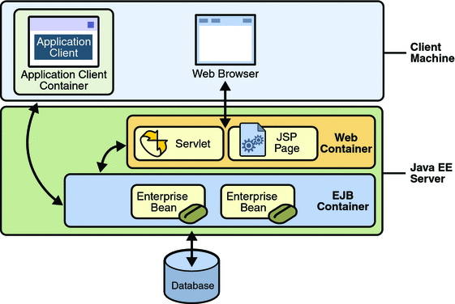
JEE Containers

Slide 12
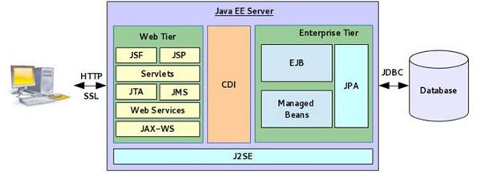
JEE Containers

Slide 13
Apache Tomcat

Slide 14
Apache Tomcat
Apache Tomcat is an open source web server and servlet container
Tomcat implements the Java Servlet and the JavaServer Pages (JSP) specifications from Oracle, and provides a "pure Java" HTTP web server environment for Java code to run in.
In the simplest configuration Tomcat runs in a single operating system process. The process runs a Java virtual machine (JVM). Every single HTTP request from a browser to Tomcat is processed in the Tomcat process in a separate thread.
Apache Tomcat includes tools for configuration and management, but can also be configured by editing XML configuration files.
Notes:
Apache Tomcat (or simply Tomcat, formerly also Jakarta Tomcat) is an open source web server and servlet container developed by the Apache Software Foundation(ASF).
Tomcat implements the Java Servlet and the JavaServer Pages (JSP) specifications from Oracle, and provides a "pure Java" HTTP web server environment for Java code to run in. In the simplest configuration Tomcat runs in a single operating system process.
The process runs a Java virtual machine (JVM). Every single HTTP request from a browser to Tomcat is processed in the Tomcat process in a separate thread.
Apache Tomcat includes tools for configuration and management, but can also be configured by editing XML configuration files.

Slide 15
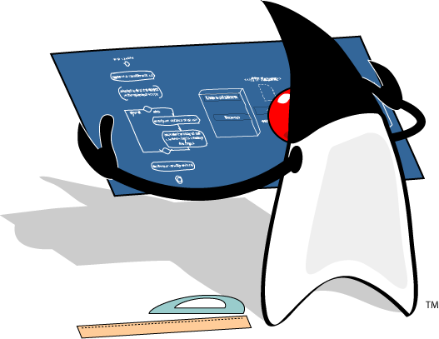
Apache Tomcat - workshop
Open file Workshop 1 - Server configuration.docx
Begin workshop

Slide 16
Web applications - architecture

Slide 17

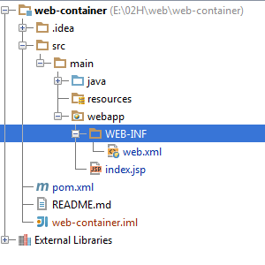
Web applications - architecture
Maven standardizes the sources structure of a web application
src/main/java –JAVA classes
src/main/resources – configuration resources
src/main/web-app –web resources – jsp pages, static pages
src/main/web-app/WEB-INF – configuration files for web applications

Slide 18
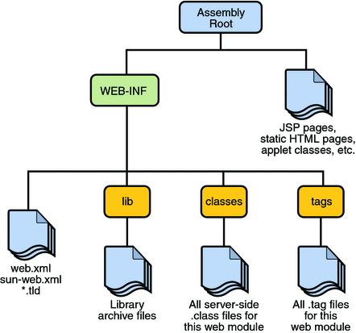
Web applications - architecture
.war archive architecture
Notes:
The web applications that are deployed in our container are archives with the “.war” extension
It is mandatory that the web archive contains the folder /WEB-INF in the structure
Under WEB-INF folder we’ll have another folder named /lib where we’ll find all the “.jar” dependencies of our web application
Under WEB-INF folder we’ll have another folder named /classes where we’ll find all the compiled classes of our application
Under WEB-INF folder we’ll find a file named web.xml, if we use the 2.x version of the Servlet API
They are portable because they are written in JAVA

Slide 19
Web applications - workshop
Open file Workshop 2 - Web application.docx
Begin workshop

Slide 20
Request - Response model

Slide 21
Request - Response model
Request–response or Request–reply is one of the basic methods computers use to communicate to each other.
When using request–response, the first computer sends a request for some data and the second computer responds to the request.
Browsing a web page is an example of request–response communication.
One can think of request–response as being like a telephone call, where you call someone and they answer the call.

Slide 22


Request - Response model
The client’s request contains the name and address (the URL), of the thing the client is looking for.
HTTP
Request
Server
request
<html>
<head>
<body>
…
<html>
<head>
<body>
…
response
Client
HTTP
HTML
The server’s response contains the actual document that the client requested (or an error code if the request could not be processed).
Notes:
Web browser
may be the client and an application running on a computer hosting a web site may be the server. The client submits an HTTP request message to the server. The server, which provides resources such as HTML files and other content, or performs other functions on behalf of the client, returns a response message to the client. The response contains completion status information about the request and may also contain requested content in its message body.

Slide 23
Request - Response model
HTTP Request key elements:
HTTP method
The page to access - URL
Form parameters
HTTP Response key elements :
Status code
Context-type
The content

Slide 24
HTTP

Slide 25
HTTP
HTTP – Hypertext Transfer Protocol
is an application protocol for distributed, collaborative, information systems
is the foundation of data communications for www
functions as a request-response protocol in the client-server computing model
URL – Uniform Resource Locator
is a specific character string that constitutes a reference to a resource
Form Parameters
represent values that are sent with the request

Slide 26
HTTP
Status code - (HTTP) response status codes
specifies one of five classes of response:
1xx – Informational
2xx – Success
3xx – Redirection
4xx – Client Error
5xx – Server Error
Context-type header
describes the data contained in the body fully enough that the receiving user agent can pick an appropriate agent or mechanism to present the data to the user
The content
is the data received by the client from the server

Slide 27
HTTP - Methods
The most commonly used are :
GET - Request to retrieve a resource such as an HTML file or an image file.
POST - Request for the server to accept the data being sent from the client to insert new server data.
PUT - Request for the server to accept the data being sent from the client to modify existing server data.
DELETE - Request for the server to delete a specific resource.
Notes:
The most commonly used are : GET, POST, PUT and DELETE
GET - Requests a representation of the specified resource.
Requests using GET should only retrieve data and should have no other effect.
Using GET client data is transmitted to server in URL as query strings(name/value pairs)
Query String is the part from URL that proceed “?” character
A GET Example /test/demo_form.jsp?name1=value1&name2=value2
POST – Submits data to be processed to a specified resource
Using POST data is transmitted to server in request body
POST /test/demo_form.jsp HTTP/1.1 Host: w3schools.com name1=value1&name2=value2

Slide 28
HTTP - GET v/s POST
GET
The client data is transmitted to server in URL as query strings(name/value pairs)
QueryString is the part from URL that proceed “?” character
GET example : URL -> …/test/demo_form.jsp?name1=value1&name2=value2
POST
Submits data to be processed to a specified resource
Using POST data is transmitted to server in request body
POST example : URL -> …/test/demo_form.jsp HTTP/1.1
Body -> name1=value1&name2=value2

Slide 29
HTTP - GET v/s POST
 | GET | POST
HTTP Request | The request contains only the request line and HTTP header. | Along with request line and header it also contains HTTP body.
Parameter passing | The form elements are passed to the server by appending at the end of the URL. | The form elements are passed in the body of the HTTP request.
Size | The parameter data is limited (the limit depends on the container) | Can send huge amount of data to the server.
Idempotency | GET is Idempotent | POST is not idempotent
Usage | Generally used to fetch some information from the host. | Generally used to process the sent data.

Slide 30
Servlets

Slide 31
Servlets
The servlet is a Java programming language class used to extend the capabilities of a server.
Servlets can respond to any types of requests, they are commonly used to extend the applications hosted by web servers
A servlet is an object that receives request and generates response based on that request
The servlet is an interface under the javax.servlet package from servlet API
A common used implementation is javax.servlet.http.HttpServlet
You could extends this class to implement your own servlet

Slide 32
Servlets - lifecycle
The Servlet lifecycle is simple, there is only one main state – “Initialized”.
Does not exist
constructor()
destroy()
init()
Initialized
Service()

Slide 33
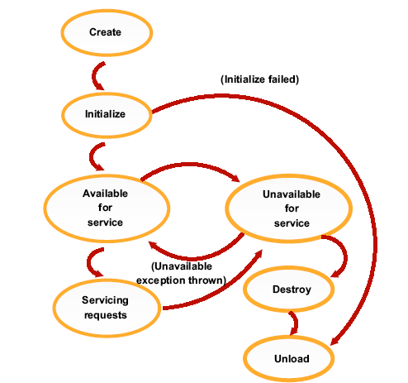
Servlets - lifecycle
The server will automatically call:
public void init():
Called only once when serlvet is being
created.
Good place for set up, open Database,
etc.
public void service():
Called once for each request.
In HttpServlet, it delegates
requests to doGet, doPost, etc.
public void destroy():
Called when server decides to
terminate the servlet.
Release resources.

Slide 34
JEE Containers & Web Container
How does the HTTP Servlet handle a request?
request
GET.
…..
Servlet
Web
Container
request
Thread Pool
Http request
response
Thread
Client
Web
Server
response
response
<Html>
<Body>
…….
</Body>
</Html>
Service()
HTTP
HTML
doGet()

Slide 35
Servlets - lifecycle
 | When is it called | What it’s for | Do you override it
init() | The container calls the init() before the servlet can service any client requests. | To initialize your servlet before handling any client requests. | Possibly
service() | When a new request for that servlet comes in. | To determine which HTTP method should be called. | No. Very unlikely
doGet() or doPost() | The service() method invokes it based on the HTTP method from the request. | To handle the business logic. | Always

Slide 36
Servlets – Deployment Descriptor
Web.xml
Is the deployment descriptor file for web applications and is part of the servlet standard for web applications
determines how URLs map to servlets, which URLs require authentication, and other information
The file is an XML file whose root element is <web-app>
<servlet>
<servlet-name>myServlet</servlet-name>
<servlet-class>class name</servlet-class>
</servlet>
<servlet-mapping>
<servlet-name>myServlet</servlet-name>
<url-pattern>/myServlet</url-pattern>
</servlet-mapping>
Notes:
The web applications that are deployed in our container are archives with the “.war” extension
It is mandatory that the web archive contains the folder /WEB-INF in the structure
Under WEB-INF folder we’ll have another folder named /lib where we’ll find all the “.jar” dependencies of our web application
Under WEB-INF folder we’ll have another folder named /classes where we’ll find all the compiled classes of our application
Under WEB-INF folder we’ll find a file named web.xml, if we use the 2.x version of the Servlet API
They are portable because they are written in JAVA

Slide 37
Servlets - custom http servlet
Interface
javax.servlet.Servlet
Abstract class
javax.servlet.GenericServlet
If not overridden, implements init()
method from the ‘Servlet’ interface,
Abstract class
javax.servlet.http.HttpServlet
If not overridden, implements service()
method.
Concrete class
Your Servlet
We implement the HTTP methods
here.
Notes:
public interface Servlet {…}
public abstract class HttpServlet extends GenericServlet
implements java.io.Serializable{…}
To create your own servlet you must extend HttpServlet and override doGet or doPost method

Slide 38
Servlets - custom http servlet
In web.xml you have to declare the servlet and map it to a url or multiple urls :
<servlet>
<servlet-name>HelloWorld</servlet-name>
<servlet-class>ro.teamnet.z2h.web.HelloWorldServlet</servlet-class>
</servlet>
<servlet-mapping>
<servlet-name>HelloWorld</servlet-name>
<url-pattern>/hello</url-pattern>
</servlet-mapping>

Slide 39
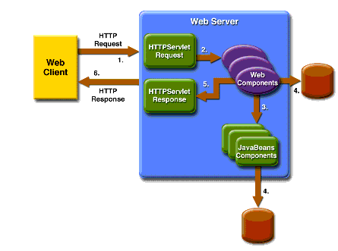
Servlets - custom servlet
The method that you’ve overridden takes two parameters:
an HttpServletRequest object – represent request from client
an HttpServletResponse object – represent response to client

Slide 40
Servlets - HttpServletRequest
Represents the client request
The mostly used methods are :
getHeaders returns all the values of the specified request
getHeaderNames returns an enumeration of all the header names
getMethod returns the http method
getQueryString returns query string
getCookies returns cookies from the client
getParameterNames returns an enumeration containing all parameters names from the client
getParameter takes an argument representing the parameter name and returns the parameter value

Slide 41
Servlets - HttpServletResponse
Represents the server response
The mostly used methods are :
getWriter returns a PrintWriter object that can send character text to the client.
setContentType sets the content type of the response . If you return an html then invoke the method with “text/html” as argument value
addHeader adds a response header with the given name and value

Slide 42
Servlets - workshop
Open file Workshop 3 - Servlets.docx
Begin workshop

